Slide 1
Chapter 8 3D Visualization
Resumes of the book
Computer Graphics using Java 2D and 3D
Computação Gráfica
Prof. Carlos Carreto
Engenharia Informática
Instituto Politécnico da Guarda

Slide 2
Objectives
Understand the concept of visualization in the 3D rendering process.
Understand the parallel and perspective projections.
Specification of a view.
Apply the standard Java 3D visualization model.
Apply the compatibility mode with OpenGL.
Apply picking to a 3D scene.
Apply head tracking to a 3D scene.

Slide 3
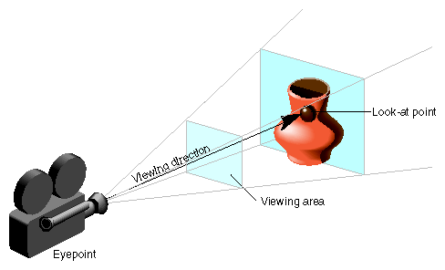
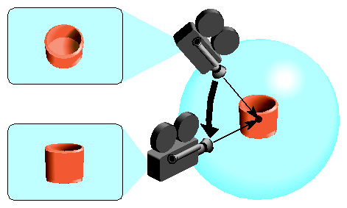
3D Visualization

Slide 4
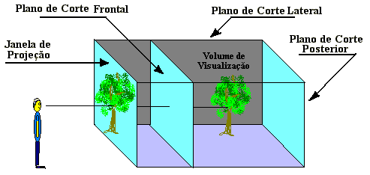
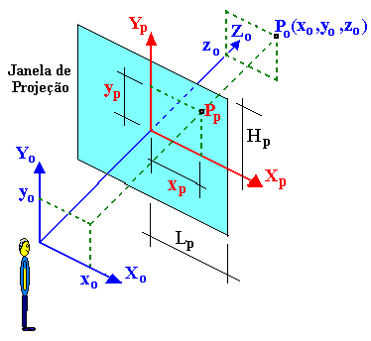
Parallel Projection
Fonte: http://www.atcsystems.com.br/upload/nt-01/ComputacaoGrafica.htm

Slide 5

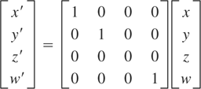
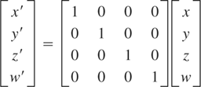
Parallel Projection
The projectors are perpendicular to the plane of projection.
Matrix of transformation of the parallel projection
The point (x, y, z) is simply mapped at the point (x, y) of the view plane.
It is usually desirable to store the z coordinate to determine the hidden parts of the objects, so the parallel projection matrix is the identity matrix:

Slide 6
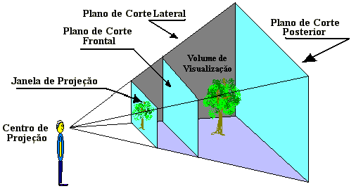
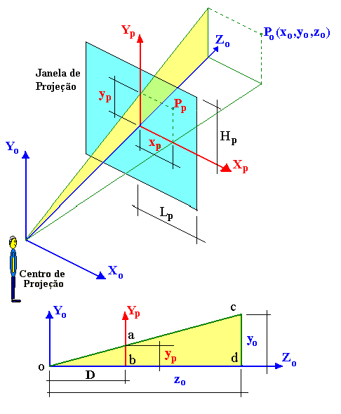
Perspective Projection
ab / ob = cd / od
ou
y_{p} / D = y₀ / z₀
Doing the same in relation to the plan X₀,Z₀ we obtain:
x_{p} / D = x₀ / z₀
and therefore,
x_{p} = D . (x₀ / z₀ )
y_{p} = D . (y₀ / z₀ )
Fonte: http://www.atcsystems.com.br/upload/nt-01/ComputacaoGrafica.htm
6

Slide 7
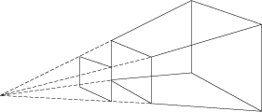
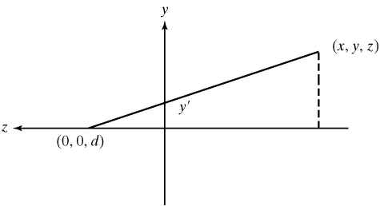
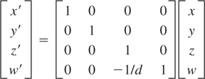


Perspective Projection
The projectors converge to the point of view (center of the projection).
Frustum
Perspective projection matrix:
By the similarity between triangles:
7

Slide 8
Specification of a View
It is divided into two parts:
Definition of the viewing volume (projection matrix).
Position of the view / camera (display matrix).
In analogy with the camera, the viewing volume corresponds to the characteristics of the camera itself, such as focal length and field of view, and the positioning of the view corresponds to the positioning and orientation of the camera.
8

Slide 9
Parameters of the View Volume
Projection - Parallel projection or perspective.
View Plate - rendered image window. It is usually a rectangular region. In a real camera is the frame of the movie.
Field of view (fov) - the horizontal angle between the left and right frustum planes.
Focal length - distance between the view plate and the camera position.
Aspect ratio - the ratio between the width and height of the view plate.
Front clip plane - the anterior plane of the frustum (which is closest to the chamber).
Back plane clip - the posterior plane of the frustum (which is further away from the chamber).
9

Slide 10
Parameters of the View Volume (Frustum)
Aspect ratio (width/height)
View Plate
Field of View (fov)
Focal length (f)
Front clip plane
Back clip plane
10

Slide 11
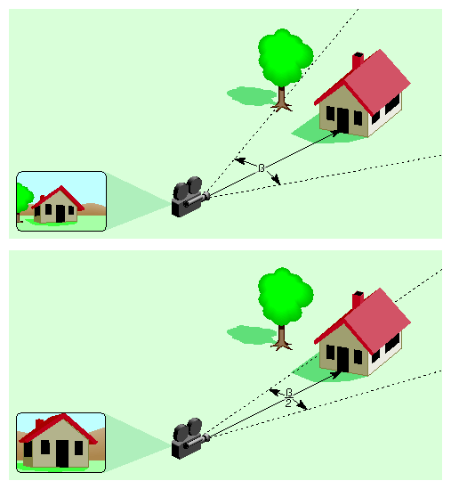
Parameters of the View Volume
11

Slide 12


Parameters of the View Volume
Some of the parameters are related to each other:
Projection on a real camera:
In computer graphics it is more convenient to formulate the visualization system with the view plate in front of the observer:
12

Slide 13
Projection Matrix (Observer Coordinates)
Front Plan:
Back plane:
+b’
+b
-a’
-a
+a’
-c
+a
-d
-b
-b’
13

Slide 14
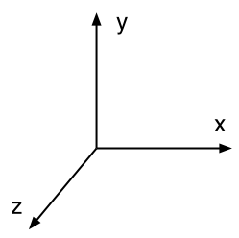
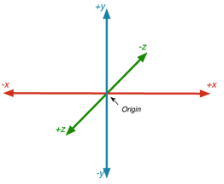
Projection Matrix (Observer Coordinates)
14

Slide 15
Projection Matrix (Observer Coordinates)
Front Plan:
Back plane:
15

Slide 16

View Positioning Visualization Matrix
Viewpoint, view-reference point (vrp, eye) - Position of the camera or observer.
View center - the center of the view plate, or the point where the viewer is looking.
View up direction (up) - the upward direction from the observer's point of view.
View plane - the plane of the projected image.
View plane normal (vpn) - the normal od the view plane.
16

Slide 17
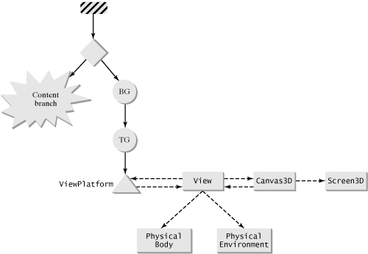
Java 3D View Model
The Java 3D API has a very versatile visualization system that supports dynamic adjustments based on environmental changes detected by external devices, as well as a traditional view based on a static camera.
17

Slide 18
Java 3D View Model
Classe Transform3D (define a posição e orientação da vista):
void lookAt(Point3d eye, Point3d look, Vector3d up)
Classe View () (define o volume de visualização e a projecção):
void setFieldOfView(double fov)
void setFrontClipDistance(double d)
void setBackClipDistance(double d)
void setProjectionPolicy(int projection)
Classe ViewPlatform (defines the presence of the view in the virtual world)
PhisicalBody and PhisicalEnvironment classes (used for automatic calibration with dynamic visualization systems such as HMDs and trace sensors)
Classes Screen3D (used to describe display devices)
Classes Canvas3D (represents the rendering surface)
18

Slide 19
3D View Configuration
Classe Transform3D:
void lookAt(Point3d eye, Point3d look, Vector3d up)
Classe View:
void setFieldOfView(double fov)
void setFrontClipDistance(double d)
void setBackClipDistance(double d)
void setProjectionPolicy(int projection)
19

Slide 20
Compatibility Mode
Simple mode compatible with OpenGL.
Static camera.
Manual setting of fixed display parameters.
Classe View:
public void setCompatibilityModeEnable(boolean enabled)
public void setVpcToEc(Transform3D viewingMatrix)
public void setLeftProjection(Transform3D projectionMatrix)
public void setRightProjection(Transform3D projectionMatrix)
Classe Transform3D:
public void lookAt(Point3d eye, Point3d look, Vector3d up)
public void perspective(double fov, double aspect, double near,
double far)
public void frustum(double left, double right, double bottom, double top,
double near, double far)
public void ortho(double left, double right, double bottom, double top,
double near, double far)
20

Slide 21
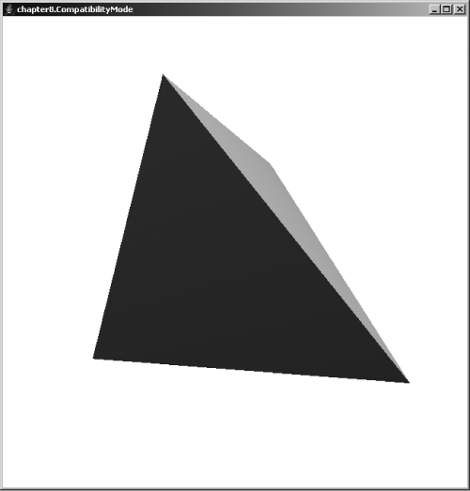
Compatibility Mode
Code
Run
21

Slide 22
Compatibility Mode
private BranchGroup createView(Canvas3D cv) {
BranchGroup bg = new BranchGroup();
ViewPlatform platform = new ViewPlatform();
bg.addChild(platform);
View view = new View();
view.addCanvas3D(cv);
view.setCompatibilityModeEnable(true);
view.attachViewPlatform(platform);
Transform3D projection = new Transform3D();
projection.frustum(-0.1, 0.1, -0.1, 0.1, 0.2, 10);
view.setLeftProjection(projection);
Transform3D viewing = new Transform3D();
Point3d eye = new Point3d(0,0,1);
Point3d look = new Point3d(0,0,-1);
Vector3d up = new Vector3d(0,1,0);
viewing.lookAt(eye, look, up);
view.setVpcToEc(viewing);
PhysicalBody body = new PhysicalBody();
view.setPhysicalBody(body);
PhysicalEnvironment env = new PhysicalEnvironment();
view.setPhysicalEnvironment(env);
return bg;
}
22

Slide 23
3D View Configuration with SimpleUniverse
SimpleUniverse
Viewer
View
ViewAvatar
ViewingPlatform
ViewPlatform
PhysicalBody
PhysicalEnvironment
Canvas3D
. . .
Canvas3D
MultiTrasformGroup
TransformGroup
. . .
TransformGroup
23

Slide 24
3D View Configuration with SimpleUniverse
To obtain the TransformGroup:
TransformGroup tg =
su.getViewingPlatform().getViewPlatformTransform();
To obtain a specific TransformGroup:
TransformGroup tg =
su.getViewingPlatform().getMultiTransformGroup().getTransformGroup(idx);
To obtain the View:
View view = su.getViewer().getView();
24

Slide 25
3D View Configuration with SimpleUniverse
Compatibility mode: false
Projection: perspective
Field of view: π / 4
Distance to front plane: 0.1
Distance to back plane: 10
. . .
SimpleUniverse su = new SimpleUniverse(cv);
su.getViewingPlatform().setNominalViewingTransform();
. . .
25

Slide 26
3D View Configuration with SimpleUniverse
. . .
SimpleUniverse su = new SimpleUniverse(cv);
su.getViewingPlatform().setNominalViewingTransform();
. . .
+1
-1
+1
-1

Slide 27
3D View Configuration with SimpleUniverse
Example of default parameter change:
SimpleUniverse su = new SimpleUniverse(cv);
TransformGroup tg = su.getViewingPlatform().getMultiTransformGroup().getTransformGroup(0); Transform3D tx = new Transform3D();
tx.lookAt(new Point3d(1,1,1), new Point3d(0,0,0), new Vector3d(0,1,0)); tx.invert();
tg.setTransform(tx);
View view = su.getViewer().getView();
view.setFieldOfView(Math.PI/3);
27

Slide 28
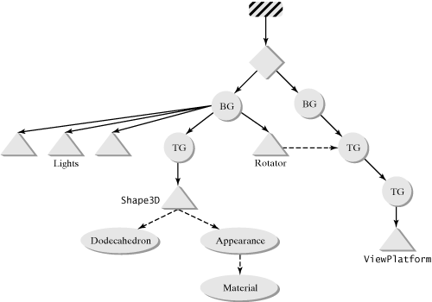
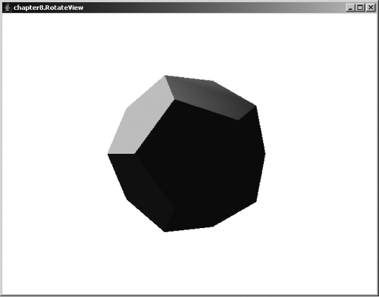
3D View Configuration with SimpleUniverse
Code
Run
28

Slide 29
3D View Configuration with SimpleUniverse
SimpleUniverse su = new SimpleUniverse(cv, 2); su.getViewingPlatform().setNominalViewingTransform();
BranchGroup bg = createSceneGraph(su.getViewingPlatform(). getMultiTransformGroup().getTransformGroup(0));
. . .
//view rotator
Alpha alpha = new Alpha(-1, 4000);
RotationInterpolator rotator = new RotationInterpolator(alpha, vtg); BoundingSphere bounds = new BoundingSphere(); rotator.setSchedulingBounds(bounds);
root.addChild(rotator);
29

Slide 30
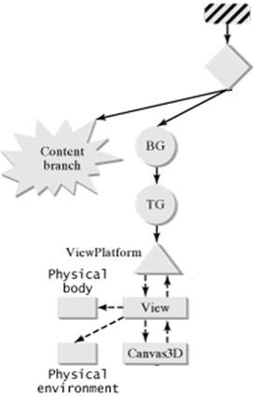
Create Your Own View
View branch:
View view = new View(); view.setProjectionPolicy(View.PARALLEL_PROJECTION);
ViewPlatform vp = new ViewPlatform();
view.addCanvas3D(cv);
view.attachViewPlatform(vp);
view.setPhysicalBody(new PhysicalBody());
view.setPhysicalEnvironment(new PhysicalEnvironment());
Transform3D trans = new Transform3D();
trans.lookAt(eye, center, vup);
trans.invert();
TransformGroup tg = new TransformGroup(trans);
tg.addChild(vp);
BranchGroup bgView = new BranchGroup();
bgView.addChild(tg);
30

Slide 31
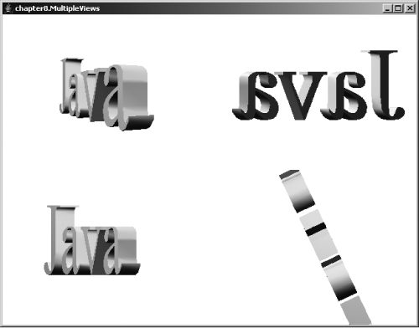
Multiple Views
Code
Run
31

Slide 32
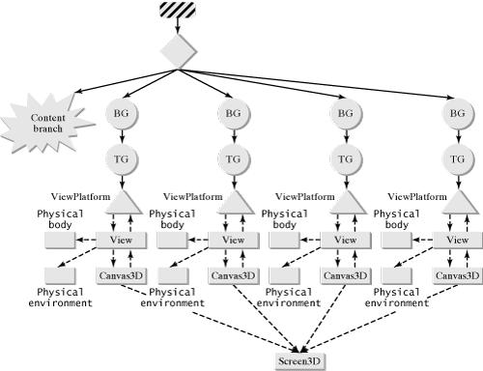
Multiple Views
32

Slide 33
Multiple Views
public void init() {
// create 4 Canvas3D objects
this.setLayout(new GridLayout(2,2));
GraphicsConfiguration gc = SimpleUniverse.getPreferredConfiguration();
// first view: standard
Canvas3D cv = new Canvas3D(gc);
add(cv);
SimpleUniverse su = new SimpleUniverse(cv);
su.getViewingPlatform().setNominalViewingTransform();
// second view: x direction
cv = new Canvas3D(gc);
add(cv);
BranchGroup bgView = createView(cv, new Point3d(2.7,0,0),
new Point3d(0,0,0), new Vector3d(0,1,0));
su.addBranchGraph(bgView);
// third view: z direction
cv = new Canvas3D(gc);
add(cv);
bgView = createView(cv, new Point3d(0, 0, 2.7),
new Point3d(0,0,0), new Vector3d(0,1,0));
su.addBranchGraph(bgView);
// fourth view: y direction
cv = new Canvas3D(gc);
add(cv);
bgView = createView(cv, new Point3d(0,2.7,0),
new Point3d(0,0,0), new Vector3d(0,0,1));
su.addBranchGraph(bgView);
// content branch
BranchGroup bg = createSceneGraph();
bg.compile();
su.addBranchGraph(bg);
}
33

Slide 34
Multiple Views
private BranchGroup createView(Canvas3D cv, Point3d eye,
Point3d center, Vector3d vup) {
View view = new View();
view.setProjectionPolicy(View.PARALLEL_PROJECTION);
ViewPlatform vp = new ViewPlatform();
view.addCanvas3D(cv);
view.attachViewPlatform(vp);
view.setPhysicalBody(new PhysicalBody());
view.setPhysicalEnvironment(new PhysicalEnvironment());
Transform3D trans = new Transform3D();
trans.lookAt(eye, center, vup);
trans.invert();
TransformGroup tg = new TransformGroup(trans);
tg.addChild(vp);
BranchGroup bgView = new BranchGroup();
bgView.addChild(tg);
return bgView;
}
34

Slide 35
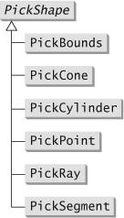
Picking
Operation to select objects from the rendered image.
A point selected in the 2D plane corresponds to a ray of points which are projected at that point.
Considering a disk instead of a point, to allow a certain tolerance, the ray will be a cylinder (in a parallel projection), or a cone (in a perspective projection).
The PickShape class family defines several different shapes for use in the picking operation
35

Slide 36
Picking
The basic picking operation is performed by creating a PickShape object and calling one of the Pick methods of the BranchGroup or Locale classes:
SceneGraphPath[] pickAll(PickShape pickShape)
SceneGraphPath[] pickAllSorted(PickShape pickShape)
SceneGraphPath pickAny(PickShape pickShape)
SceneGraphPath pickClosest(PickShape pickShape)
A SceneGraphPath object represents a path from the Locale object, to an end node in the scene graph.
Example:
Point3d origin = new Point3d(0,0,0);
Vector3d direction = new Vector3d(0,1,-1);
PickShape pickShape = new PickRay(origin, direction);
SceneGraphPath[] paths = branchGroup.pickAll(pickShape);
for (int i = 0; i < paths.length; i++) {
<operations on paths[i]...>
}
36

Slide 37
Picking
Picking ray
37

Slide 38
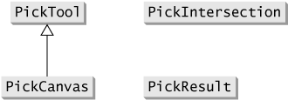
Picking
The most common application of the picking operation is to interactively select objects in a rendered image. To simplify this process there are four classes we can use to perform generic picking on a branch of a scene graph based on user interaction.
38

Slide 39
Picking
The PickTool class provides a convenient way to set up a pick shape and perform picking on a branch of the scene graph.
The class has the following picking methods:
PickResult[] pickAll()
PickResult[] pickAllSorted()
PickResult pickAny()
PickResult pickClosest()
39

Slide 40
Picking
The PickCanvas class simplifies pick shape configuration by allowing the association with a canvas, so that a mouse event can automatically generate a pick shape.
The class constructor connects to a Canvas3D object and to a BranchGroup object:
public PickCanvas(Canvas3D cv, BranchGroup bg)
40

Slide 41
Picking
The result of the picking operation is returned on objects of type PickResult that contain information about the selected object, the SceneGraphPath, and the intersection.
The PickIntersection class allows you to obtain more detailed information about the intersection of the selected object.
41

Slide 42
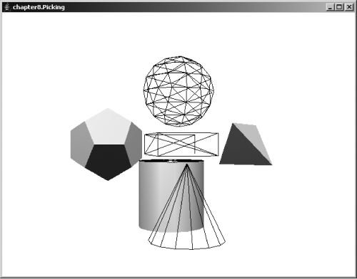
Picking
Code
Run
42

Slide 43
Picking
PickCanvas pc;
. . .
pc = new PickCanvas(cv, bg);
pc.setMode(PickTool.GEOMETRY);
. . .
57 Sphere sphere = new Sphere
(1f, Primitive.ENABLE_GEOMETRY_PICKING |
Primitive.ENABLE_APPEARANCE_MODIFY |
60 Primitive.GENERATE_NORMALS, wireframe);
. . .
88 PickTool.setCapabilities(tetra, PickTool.INTERSECT_TEST);
. . .
132 public void mouseClicked(java.awt.event.MouseEvent mouseEvent) {
133 pc.setShapeLocation(mouseEvent);
134 PickResult[] results = pc.pickAll();
135 for (int i = 0; (results != null) &&
136 (i < results.length); i++) {
137 Node node = results[i].getObject();
138 if (node instanceof Shape3D) {
139 ((Shape3D)node).setAppearance(lit);
140 System.out.println(node.toString());
141 }
142 }
143 }
43

Slide 44
Head Tracking
Adjusting the viewing parameters according to the dynamic changes of the user's head position.
Java 3D support for head tracking through classes:
View
Sensor
PhysicalBody
PhysicalEnvironment
44

Slide 45
Head Tracking
Head tracking is based on the input of certain 6DOF tracking devices, such as virtual reality HMDs.
The Java 3D API contains the InputDevice interface class that can be used to define a particular input device.
void initialize()
Sensor getSensor(int sensorIndex)
A given InputDevice implementation provides an array of Sensor objects.
A Sensor object provides the input data of a given device.
45

Slide 46
Head Tracking
The PhysicalEnvironment object contains all registered input devices.
In order to register an input device we can use the
addInputDevice(InputDevice device)
By default the PhysicalEnvironment object contains three entities with 6DOF: UserHead, DominantHand, and NondominantHand, with indexes 0, 1, and 2 respectively. To assign a sensor to the UserHead entity for example, we can call the method
setSensor(0, sensor)
46

Slide 47
Head Tracking
Head tracking is off by default. To connect it we use the View object method
setTrackingEnable(true)
There are two options for mounting the screen in a head-mounted view: room mounted and head mounted.
Void setViewPolicy(int viewPolicy)
SCREEN_VIEW
HMD_VIEW
In HMD_VIEW mode you need to change the monoscopic view:
canvas.setMonoscopicViewPolicy(View.LET_EYE_VIEW)
47

Slide 48
Head Tracking
The visual representation of the observer in the scene is called the avatar. The Viewer object in the SimpleUniverse object has an option to include the avatar of the viewer:
ViewerAvatar avatar = new ViewerAvatar();
su.getViewer().setAvatar(avatar);
The ViewerAvatar class is a subclass of the BranchGroup so the shapes for the avatar can be added to it as child nodes.
48

Slide 49
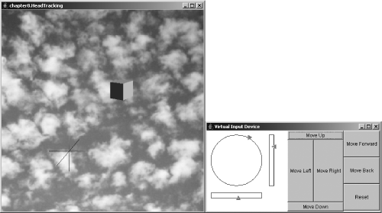
Head Tracking
Code
Run
49

Slide 50
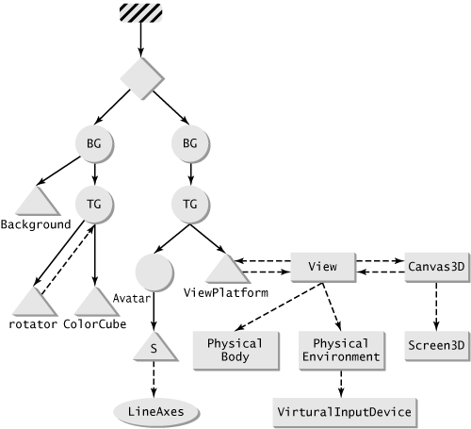
Head Tracking
50

